Slide 1


Flight On-Time Prediction and Sentiment Analysis using Pyspark
-Group 7-
Chris Lazarus : 677377993​
Pratik Sharma : 667724536​
Sayali Bonawale : 656488690​
IDS 561 Analytics for Big Data (38536) 2022 Fall

Slide 2
Overview
Problem Statement
Dataset Description
Prediction Process Flow
Exploratory Data Analysis
Methodologies Used / Model Building
Results and Performance Analysis
Sentiment Analysis

Slide 3
Problem Statement
On Time Prediction
Sentiment Analysis
On Time estimation is critical for airlines to get the degree of Customer satisfaction.
Using different ML Classification and Regression Algorithms to propose the best method.
Classification of Tweets so as to understand the Quality of Customer Experience.
Categorize the tweets: Positive or negative sentiment​

Slide 4
Dataset
Prediction Dataset :
Number of records: 275,000​
Dataset: https://www.kaggle.com/
Features: Month, Date, Day of Week, Origin, Distance, Airline ID, Flight ID, Depart, Flight Duration, Delay
Sentiment Analysis Dataset :
Number of records: 11541
Dataset: https://data.world/crowdflower
Features: Tweet ID, Comments, Airline, Name, Retweet count, Text, Created ,Location, User Timezone
On Time

Slide 5

Airline Sentiment Analysis
Tagged our sentiment feature as 0 for negative, 1 for positive and -1 as neutral.
We then generated tokens from our text tweet dataset
Processed data for removing Stop words.
Transformed data using Hashing
Trained Model using Logistic Regression and used this model for Prediction.

Slide 6
Removed Null Values,
Special Characters, Tokenizing, Stopwords
Used the LR Model to perform prediction, Performance analysis
Conducted sentiment Analysis on Twitter data
Preprocessing
EDA
Sentiment Analysis
Model Building
Prediction and Evaluation
Categorized the tweets into positive and negative.
Analysis of airlines using reasons
Logistic Regression for Model Building

Slide 7
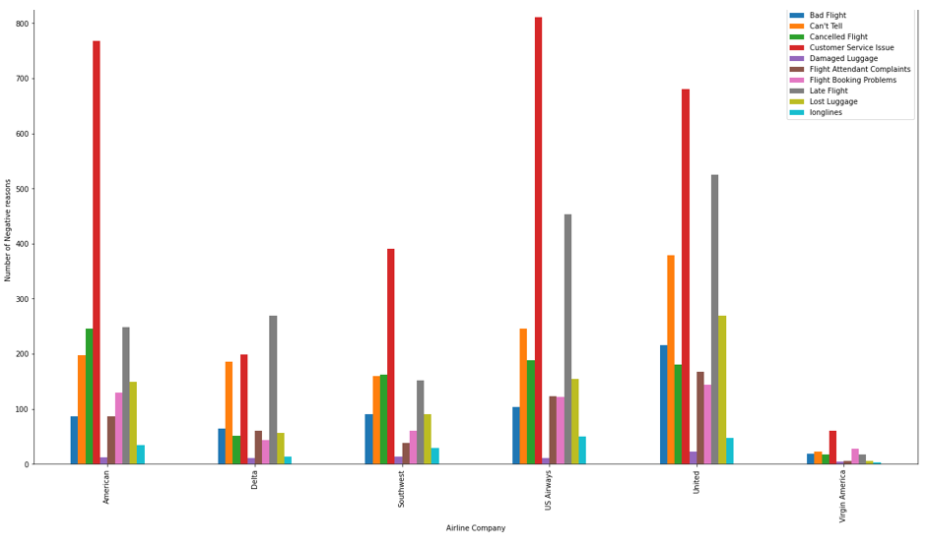
Airline Sentiment Analysis
Analysis of Airlines using additional comments and reasons

Slide 8
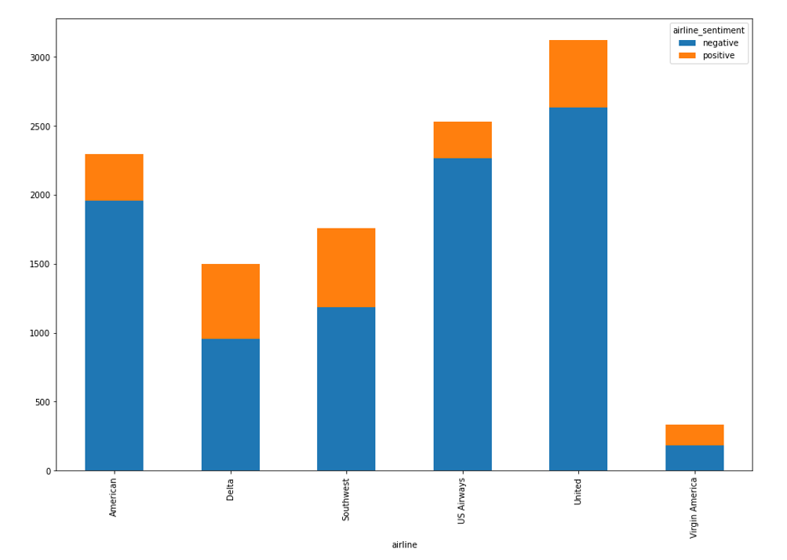
Airline Sentiment Analysis
Polarity scores of Major Airlines

Slide 9
Results and Performance Analysis
Model | Accuracy
Logistic Regression | 89.8%
Polarity scores of Major Airlines

Slide 10
On Time Prediction
Correlation Matrix

Slide 11
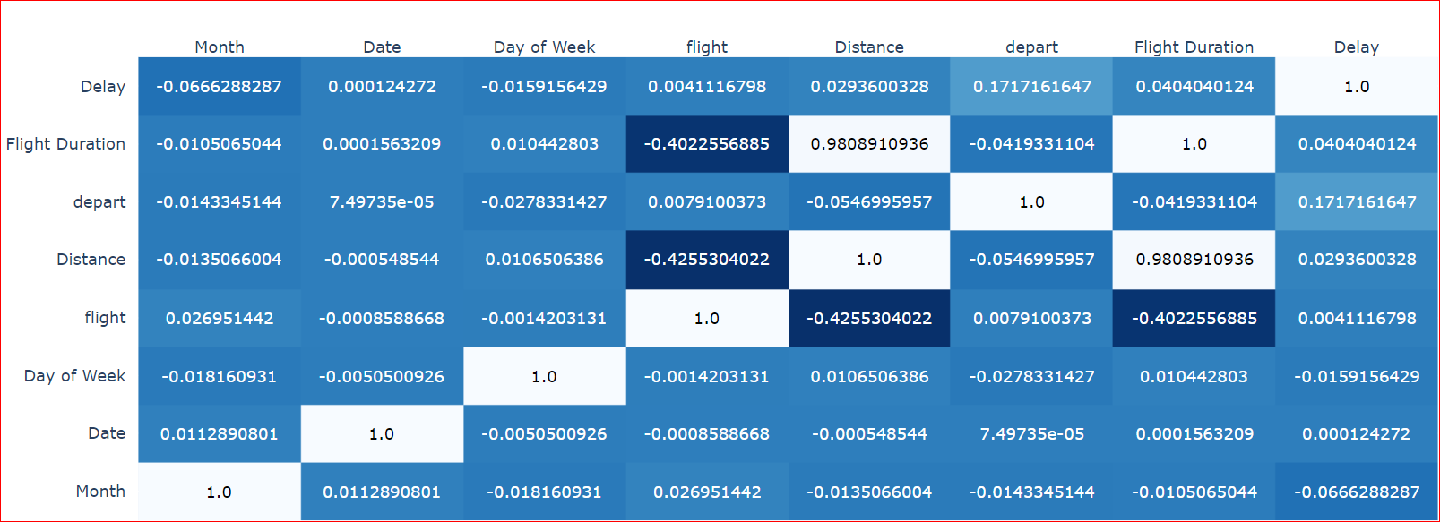
Exploratory Data Analysis
Correlation Matrix

Slide 12
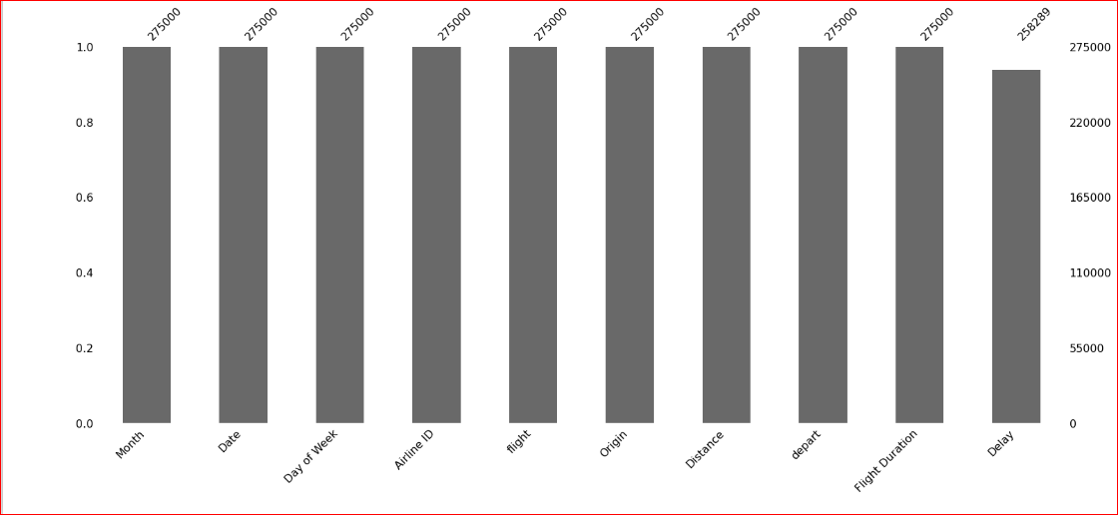
Exploratory Data Analysis
Null Value Composition

Slide 13
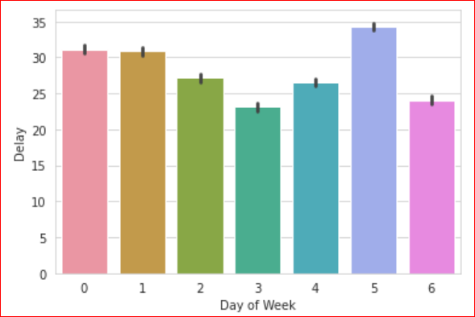
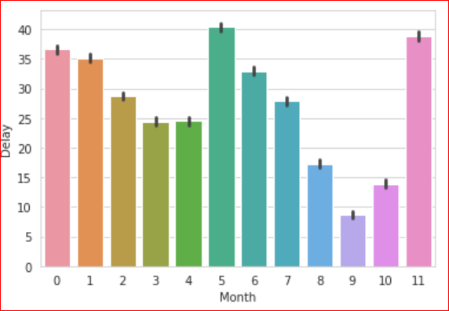
Exploratory Data Analysis
Relationship between Parameters and Target variable

Slide 14
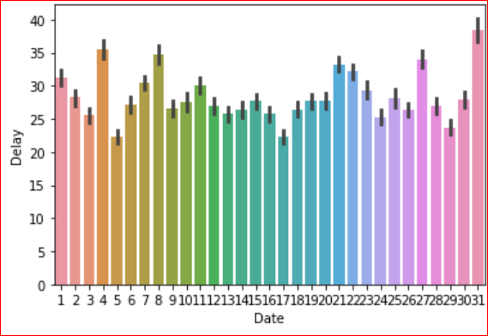
Exploratory Data Analysis
Relationship between Parameters and Target variable

Slide 15
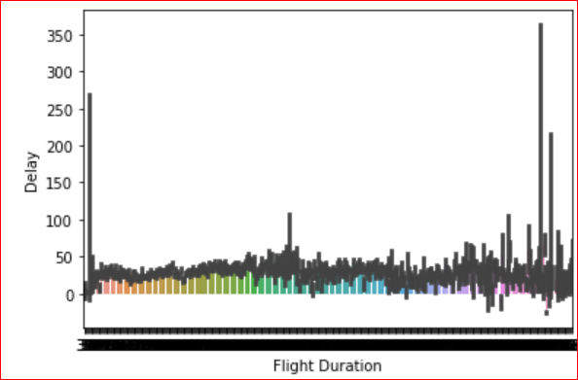
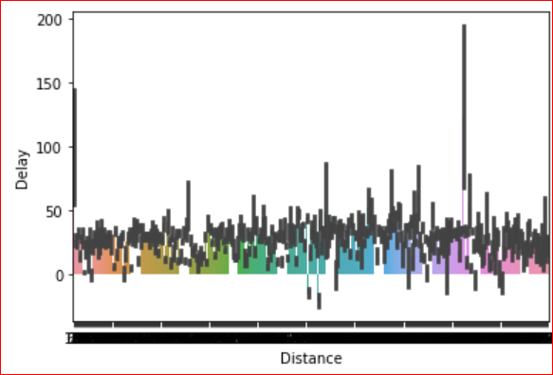
Exploratory Data Analysis
Influence of few features

Slide 16
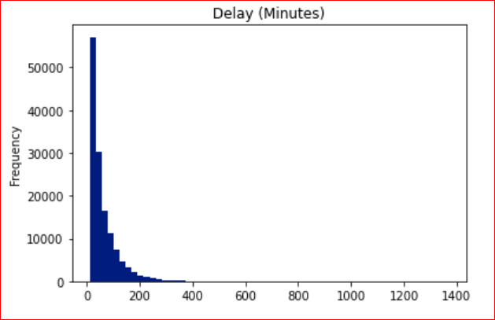
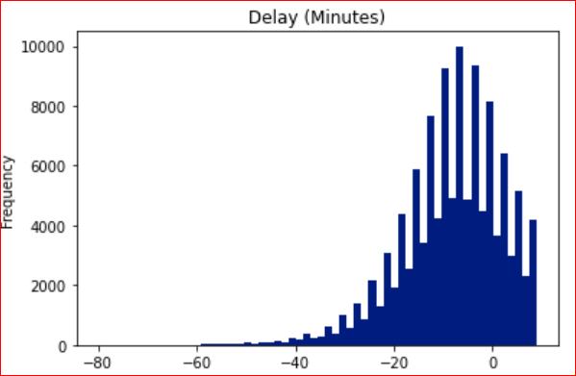
Exploratory Data Analysis
We have taken Delay threshold as 10 and analyzed the frequency of flights more and less than the threshold
Without Delay
With Delay

Slide 17
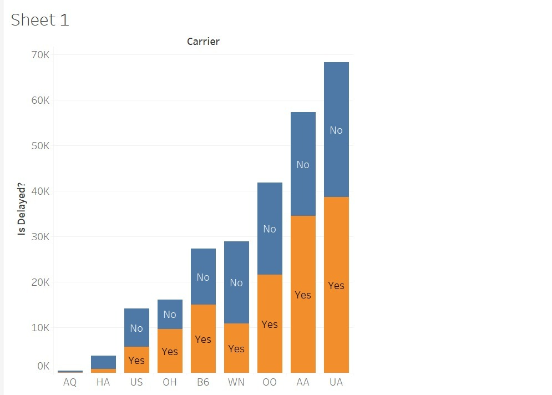
Exploratory Data Analysis

Slide 18
Correlation between parameters.
Plotting null values.
Relationship between parameters and target variable.
Influence of parameters on target.
Splitting of data into train and test.
Builded various Models based on supervised ML techniques
EDA
Preprocessing
Model Building
Prediction and Evaluation
Using the ML Models for prediction, Performance analysis
Removed Null Values
Data Wrangling
Identified delayed threshold

Slide 19
Model Building
Dataset | Algorithms Used
On Time Prediction | Decision Tree, Logistic Regression, Naive Bayes, Random Forest
Sentiment Analysis | Logistic Regression

Slide 20
Model Implementation
Setting the threshold for delay feature
Assigning the target label (0,1) based on threshold
Positive class : 1 : Delay
String Indexer : to convert a string column of labels to an ML column of label indices
Vector Assembler
Fitting Supervised learning models : Decision Tree, Logistic Regression, Naive Bayes, Random Forest

Slide 21
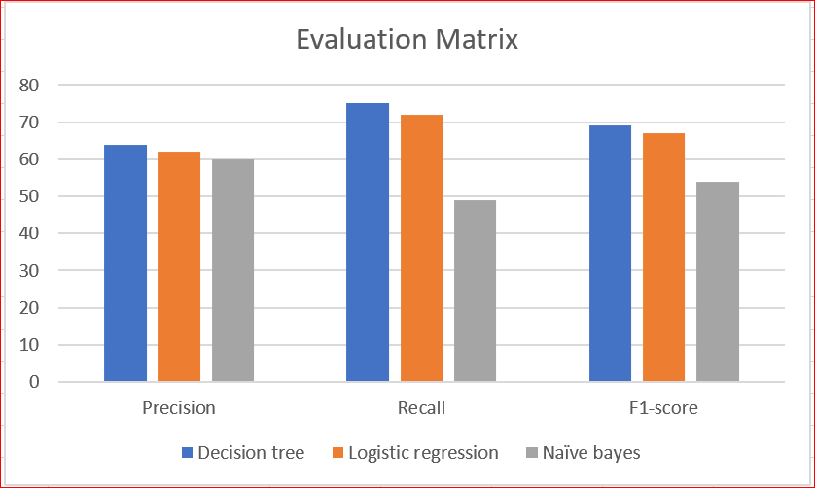
Results and Performance Analysis
Confusion matrix
Cost Analysis :Based on the label class False Negative is more costly : Recall
Logistic regression and Decision tree performs well

Slide 22
Thank You!

